Slide 1

Power and sample size
ADS2, Lecture 2.4
Dr Rob Young – robert.young@ed.ac.uk
Semester 2, 2023/24

Slide 2
Learning objectives
After this lecture, you should be able to:
Define statistical power
Explain how power relates to sample size
Discuss ethical issues around power and sample size
Use a simulation-based approach to compute power

Slide 3
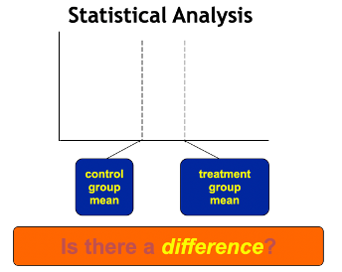
Why do we need to perform statistical tests?
Without __________ , there is no need for statistics.

Slide 4
Why do we need to perform statistical tests?
Without variability , there is no need for statistics.

Slide 5
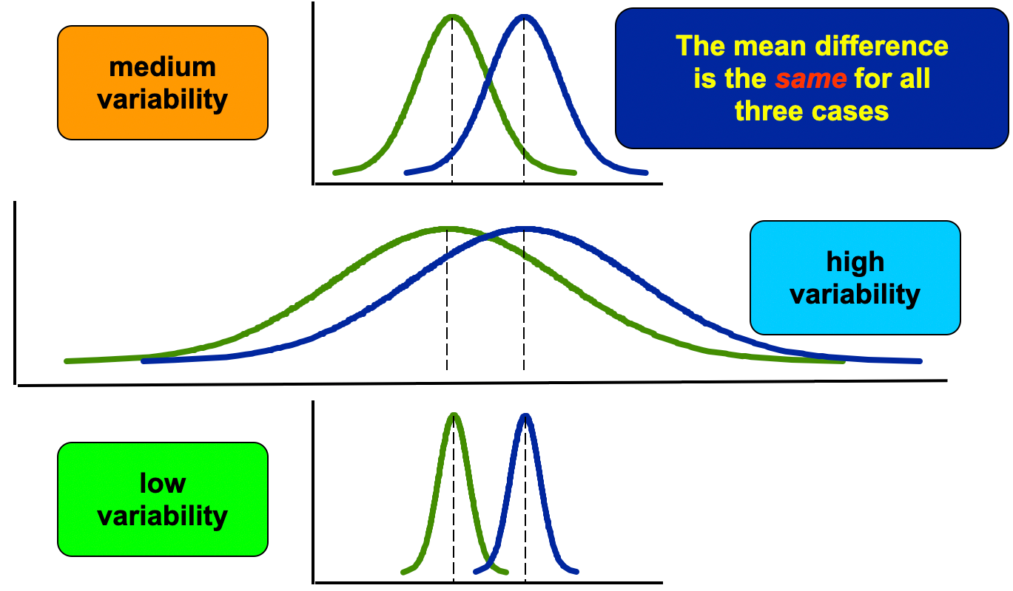
Why do we need to perform statistical tests?
Without variability , there is no need for statistics.

Slide 6
Why do we need to perform statistical tests?
Same mean values, same sample sizes, different variabilities
In which case are we most likely to reject the null hypothesis?

Slide 7
Why do we need to perform statistical tests?
Same mean values, same sample sizes, different variabilities
In which case are we most likely to reject the null hypothesis?
The lower the variability, the higher probability that we will reject the null hypothesis.

Slide 8

What is statistical power?
Statistical power is the probability that the statistical test will reject a false null hypothesis.
…or, in plain English:
Statistical power is the likelihood that a study will detect an effect when there is an effect there to be detected.

Slide 9
Why do we care about statistical power?
Lack of statistical significance does not prove that there is no difference.
Instead, it may be a consequence of low power.
Do you remember what we call cases when we reject a true null hypothesis?

Slide 10
Statistical power and β
Review – Type I and Type II error
Type I error
A Type I Error is rejecting the null hypothesis when it is true.
Prob(Type I Error) = Significance level 𝝰 = P(reject H_{o}|H_{o} true)
Type II error
A Type II error is not rejecting a null hypothesis when it is false.
Prob(Type II Error) = β = P(accept H_{o}|H₁ true)
Value of β typically depends on which particular alternative hypothesis is true.
 | H_{o} is true | H_{o} is false
Reject H_{o} | Type I Error (false positive) | Correct decision (true positive)
Do not reject H_{o} | Correct decision (true negative) | Type II Error (false negative)
this probability
= statistical power

Slide 11
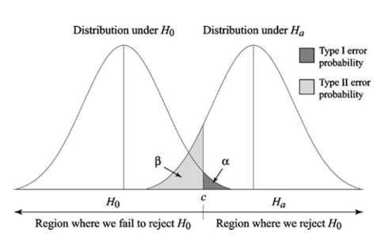
Statistical power and β
Type I error
A Type I Error is rejecting the null hypothesis when it is true.
Prob(Type I Error) = Significance level 𝝰 = P(reject H_{o}|H_{o} true)
Type II error
A Type II error is not rejecting a null hypothesis when it is false.
Prob(Type II Error) = β = P(accept H_{o}|H₁ true)
Value of β typically depends on which particular alternative hypothesis is true.
What does power equal here?
Notes:
C = cutoff
A = false positive rare
Beta = false negative rate (Ha is true but less than 5% significance rate

Slide 12
Statistical power and β
Type I error
A Type I Error is rejecting the null hypothesis when it is true.
Prob(Type I Error) = Significance level 𝝰 = P(reject H_{o}|H_{o} true)
Type II error
A Type II error is not rejecting a null hypothesis when it is false.
Prob(Type II Error) = β = P(accept H_{o}|H₁ true)
Value of β typically depends on which particular alternative hypothesis is true.
Power of a hypothesis test
Power = 1 - β = P(reject H_{o}|H₁ true)
Probability of rejecting the null hypothesis if the alternative hypothesis is true
Notes:
C = cutoff
A = false positive rare
Beta = false negative rate (Ha is true but less than 5% significance rate

Slide 13

So what power do we need?
It depends on the type of study!
In clinical trials, Phase III: industry minimum=80%
Some say Type I Error=Type II Error
Omics studies: aim for high power, because you want to minimise Type II errr
Power of a hypothesis test
Power = 1 - β = P(reject H_{o}|H₁ true)
Probability of rejecting the null hypothesis if the alternative hypothesis is true
Notes:
C = cutoff
A = false positive rare
Beta = false negative rate (Ha is true but less than 5% significance rate

Slide 14
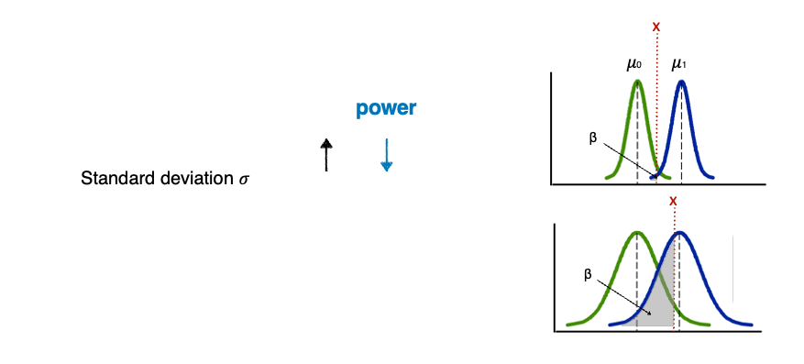
Factors affecting (statistical) power
Notes:
Beta = false negative rate (Ha is true but less than 5% significance rate)

Slide 15
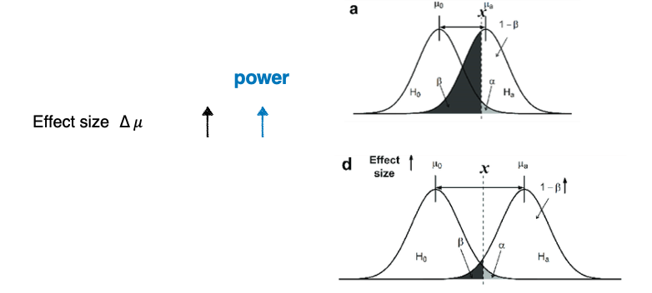
Factors affecting (statistical) power
Notes:
Beta = false negative rate (Ha is true but less than 5% significance rate)

Slide 16
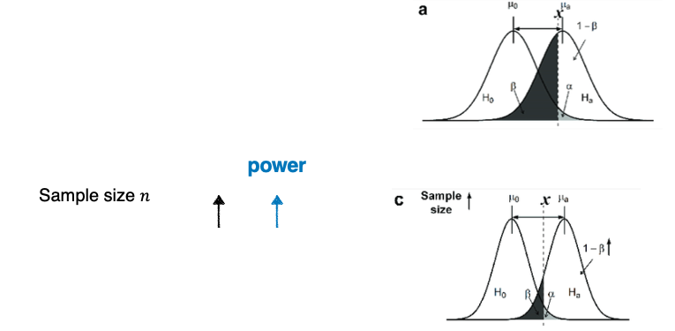
Factors affecting (statistical) power
Notes:
Sample size works because it has the effect of decreasing the standard deviation

Slide 17
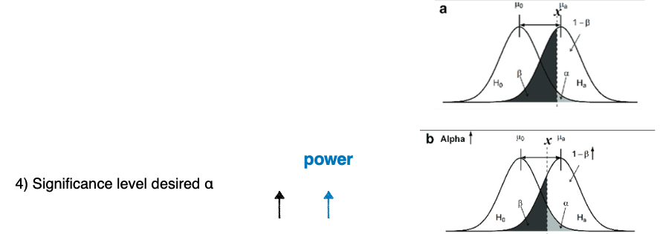
Factors affecting (statistical) power
Notes:
As you increase the significance level alpha, you go from 0.05-0.1 (so increasing the probability of a Type I error) but this therefore decreases the beta and the Type II Error

Slide 18
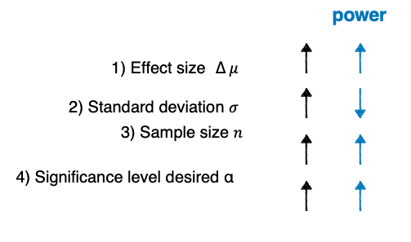
Factors affecting (statistical) power
In reality, which of the four factors can we change to increase the statistical power?
Notes:
Sample size!!

Slide 19
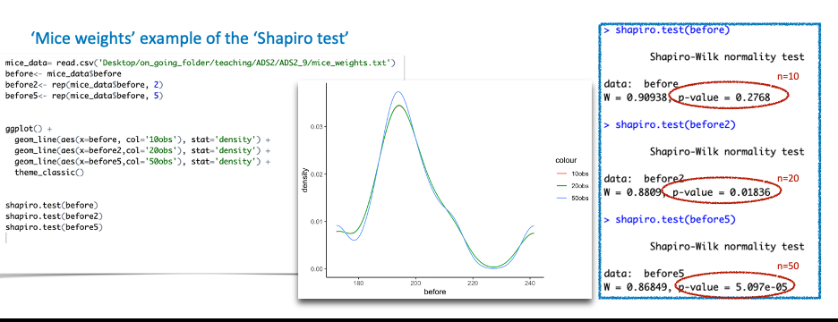
Power and sample size
In order to have enough statistical power, we need to have an adequate sample size.

Slide 20
Power and sample size
In order to have enough statistical power, we need to have an adequate sample size.

Slide 21
Choosing your power level – ethical issues
What problems do you think we will have?
Too small a sample size with an underpowered study:
Waste resources; can’t reject H_{o}
Misleading conclusions if results are nonsignificant
Unethical if the conclusions lead to inferior treatment clinically
Too big a sample size with an overpowered study:
Waste resources; especially for needless sacrifice of animals
Pick up essentially trivial results which are meaningless
Cost of collecting data > benefits

Slide 22
Choosing your power level – ethical issues
What problems do you think we will have?
Too small a sample size with an underpowered study:
Waste resources; can’t reject H_{o}
Misleading conclusions if results are nonsignificant
Unethical if the conclusions lead to inferior treatment clinically
Too big a sample size with an overpowered study:
Waste resources; especially for needless sacrifice of animals
Pick up essentially trivial results which are meaningless
Cost of collecting data > benefits

Slide 23
Stopping rules in practice
Stop after the power analysis, even before you collect samples:
If, to reach a decent power (~80%), you need to collect sample numbers that are impossible to achieve (money, time, ethical issues, etc).
Stop at different stages of clinical trials:
Clinical trials are unusual in that enrolment of subjects is a continual process staggered in time.
 | Aim | Number | When to stop?
Phase I | Drug resistance, metabolism, side-effects, etc. | < 100 (normally 20-30) | If a treatment can be proven to be clearly beneficial or harmful compared to the concurrent control, or to be obviously futile, based on a predefined analysis of an incomplete data set while the study is ongoing, the investigators may stop the study early.
Phase II | Effectiveness in a defined group compared to the placebo | At least 100
Phase III | Effective and safety compared to the existing drug | At least 300
Phase IV | Safety | > 2,000

Slide 24
Choosing your power level
It’s all about a balance between risks (𝝰 and β)
Generally, a Type I error is considered worse so 𝝰 is rarely > 0.05
Generally, if we can tolerate a 5% type I error, we can tolerate a 20% type II error
Large clinical trials use 0.9 or 0.95 (90-95% power, β = 0.1 – 0.05).
Animal studies usually use 0.8 (80% power, β = 0.2).

Slide 25
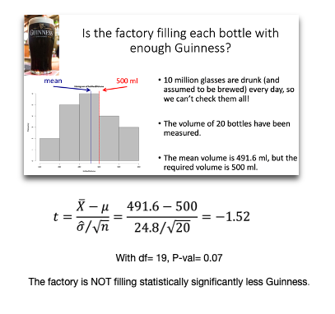
How to calculate power
Now you are probably wondering if this conclusion is due to a lack of statistical power…
…but…
Power calculations:
Depend on the study design
May not be hard, but can be very algebra intensive
May want to use use a computer program or consult a statistician (or ADS2 student!)

Slide 26
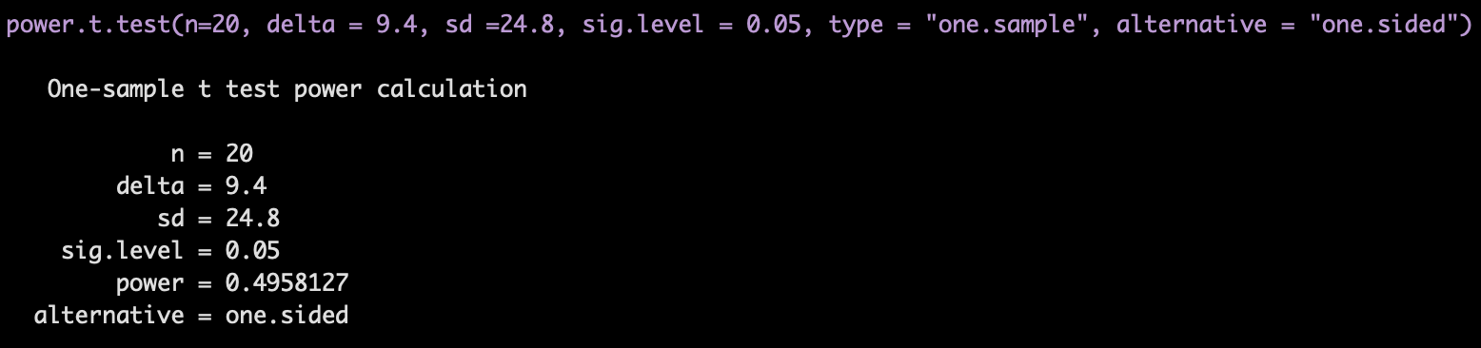
Using simulation to calculate power
Our data:
X = 491.6
sigma = 24.8
n = 20
mu = 500
Power.t.test built-in function
power.20=0.49581
Which is more reliable, in your opinion?
Simulation result in R
power.20=0.42669
Notes:
Number of simulations will yield precision of estimate
Number of simulations likely limited by compute power
We will explore these power calculations more in the practical session tomorrow

Slide 27
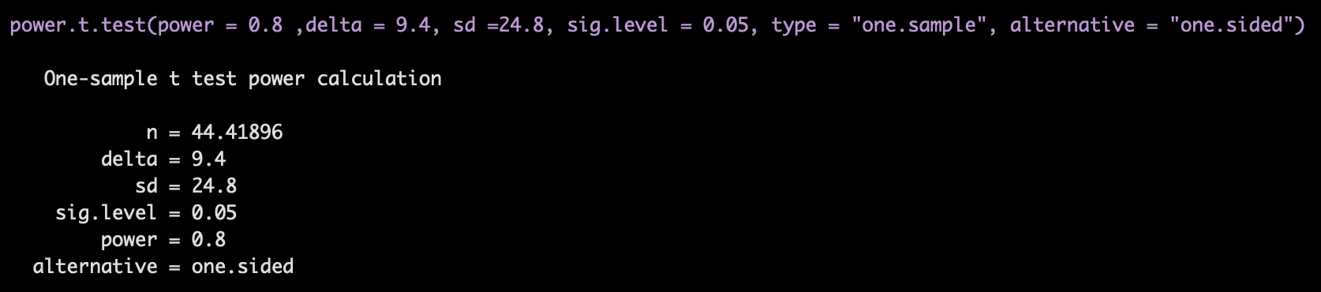
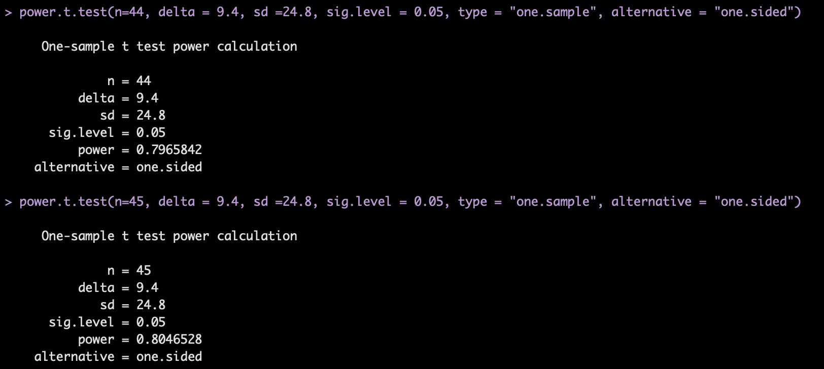
Calculating the minimum sample size
Our data:
X = 491.6
sigma = 24.8
power = 0.8
n = 20
mu = 500
What is the minimum sample size that would allow us to have power of 80%, with 𝝰 = 0.05?
Confirm by checking n=44 and n=45
Notes:
There is some complicated maths which I will not go into

Slide 28
Learning objectives
Now, you should be able to:
Define statistical power
The probability of rejecting the null hypothesis when it is false
Explain how power relates to sample size
The bigger the sample size, the higher the power
Discuss ethical issues around power and sample size
Under-powered or over-powered studied can be unethical, due to sample size-choices
Use a simulation-based approach to compute power
For a given effect size (and standard deviation), power, and alpha, you can simulate to find the minimum ‘n’

Slide 29
Power and sample size Any questions?
ADS2, Lecture 2.4
Dr Rob Young – robert.young@ed.ac.uk
Semester 2, 2023/24

